Slide 1

Capital Investment Analysis
25
Chapter
Financial and Managerial Accounting
14e
Warren
Reeve
Duchac

Slide 2
Learning Objectives
Obj. 1: Describe the nature and importance of capital investment analysis.
Obj. 2: Evaluate capital investment proposals, using the average rate of return and cash payback methods.
Obj. 3: Evaluate capital investment proposals, using the net present value and internal rate of return methods.
Obj. 4: Describe factors that complicate capital investment analysis.
Obj. 5: Describe and diagram the capital rationing process.

Slide 3
Nature of Capital Investment Analysis
(slide 1 of 3)
Companies use capital investment analysis to evaluate long-term investments.
  Capital investment analysis (or capital budgeting) is the process by which management plans, evaluates, and controls investments in fixed assets.

Slide 4
Nature of Capital Investment Analysis
(slide 2 of 3)
Capital investment evaluation methods can be grouped into the following categories:
  Methods That Do Not Use Present Values
    Average rate of return method
    Cash payback method
  Methods That Use Present Values
    Net present value method
    Internal rate of return method

Slide 5
Nature of Capital Investment Analysis
(slide 3 of 3)
The two methods that use present values consider the time value of money.
  The time value of money concept recognizes that a dollar today is worth more than a dollar tomorrow because today’s dollar can earn interest.

Slide 6
Methods Not Using Present Values
The methods not using present values are often useful in evaluating capital investment proposals that have relatively short useful lives.
  In such cases, the timing of the cash flows (the time value of money) is less important.
Because the methods not using present values are easy to use, they are often used to screen proposals.

Slide 7
Average Rate of Return Method
(slide 1 of 5)
The average rate of return, sometimes called the accounting rate of return, measures the average income as a percent of the average investment.
The average rate of return is computed as follows:
  Assuming straight-line depreciation, the average investment is computed as follows:
Estimated Average Annual Income
Average Investment
Average Rate of Return =
Initial Cost + Residual Value
2
Average Investment =

Slide 8
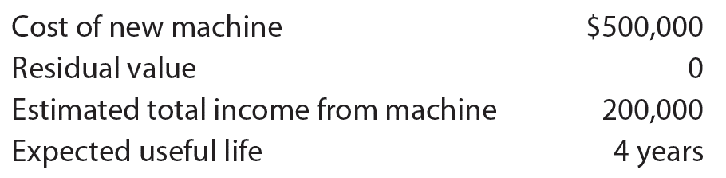
Average Rate of Return Method
(slide 2 of 5)
Assume that management is evaluating the purchase of a new machine as follows:

Slide 9
Average Rate of Return Method
(slide 3 of 5)
The average investment is computed as follows:
The average rate of return on the average investment is computed as follows:

Slide 10
Average Rate of Return Method
(slide 4 of 5)
The average rate of return of 20% should be compared to the minimum rate of return required by management.
  If the average rate of return equals or exceeds the minimum rate, the machine should be purchased or considered for further analysis.

Slide 11
Average Rate of Return Method
(slide 5 of 5)
The average rate of return has the following three advantages:
  It is easy to compute.
  It includes the entire amount of income earned over the life of the proposal.
  It emphasizes accounting income, which is often used by investors and creditors in evaluating management performance.
The average rate of return has the following two disadvantages:
  It does not directly consider the expected cash flows from the proposal.
  It does not directly consider the timing of the expected cash flows.

Slide 12
Cash Payback Method
(slide 1 of 8)
The expected period of time between the date of an investment and the recovery in cash of the amount invested is the cash payback period.
When annual net cash inflows are equal, the cash payback period is computed as follows:
Initial Cost
Annual Net Cash Inflow
Cash Payback Period =

Slide 13
Cash Payback Method
(slide 2 of 8)
Assume that management is evaluating the purchase of a new machine:
To simplify, the revenues and expenses other than depreciation are assumed to be in cash. Hence, the net cash inflow per year from use of the machine is as follows:

Slide 14

Cash Payback Method
(slide 3 of 8)
The estimated cash payback period for the investment in the machine is computed as follows:

Slide 15
Cash Payback Method
(slide 4 of 8)
In the preceding example, the annual net cash inflows are equal ($40,000 per year).
When the annual net cash inflows are not equal, the cash payback period is determined by adding the annual net cash inflows until the cumulative total equals the initial cost of the proposed investment.

Slide 16
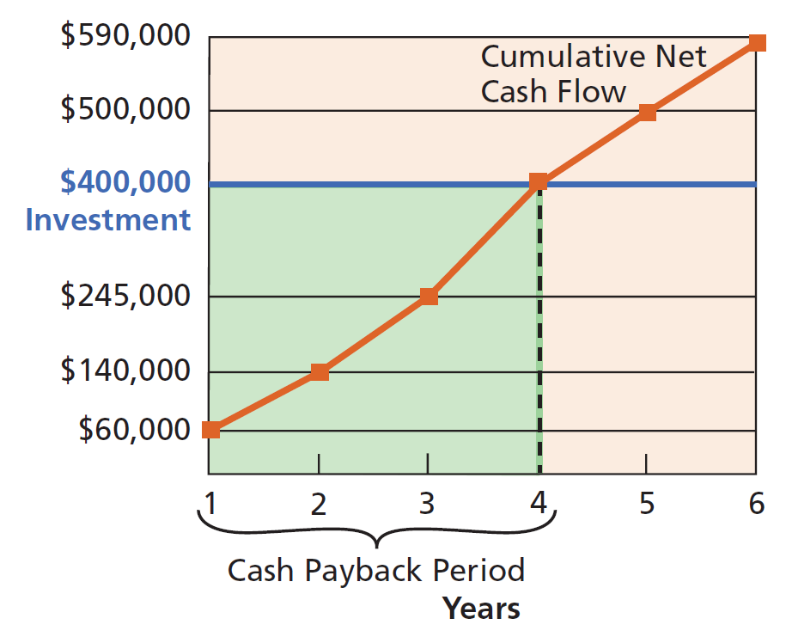
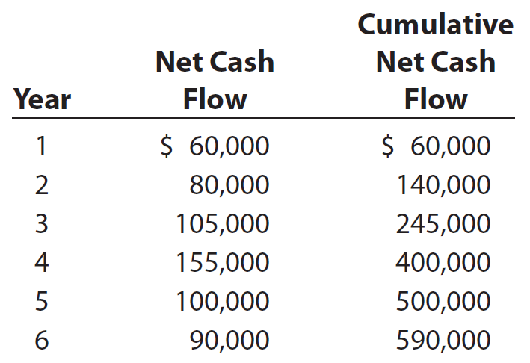
Cash Payback Method
(slide 5 of 8)
Assume that a proposed investment has an initial cost of $400,000. The annual and cumulative net cash inflows over the proposal’s six-year life are as follows:

Slide 17
Cash Payback Method
(slide 6 of 8)
The cumulative net cash flow at the end of Year 4 equals the initial cost of the investment, $400,000. Thus, the payback period is four years.

Slide 18
Cash Payback Method
(slide 7 of 8)
A short cash payback period is desirable.
  This is because the sooner cash is recovered, the sooner it can be reinvested in other projects.
  In addition, there is less chance of losses from changing economic or business conditions.
  A short cash payback period is also desirable for quickly repaying any debt used to purchase the investment.

Slide 19
Cash Payback Method
(slide 8 of 8)
The cash payback method has the following two advantages:
  It is simple to use and understand.
  It analyzes cash flows.
The cash payback method has the following two disadvantages:
  It ignores cash flows occurring after the payback period.
  It does not use present value concepts in valuing cash flows occurring in different periods.

Slide 20
Check Up Corner
Capital Investment Analysis Not Using Present Value

Slide 21
Methods Using Present Values
An investment in fixed assets may be viewed as purchasing a series of net cash flows over a period of time.
The timing of when the net cash flows will be received is important in determining the value of a proposed investment.
Present value methods use the amount and timing of the net cash flows in evaluating an investment.

Slide 22
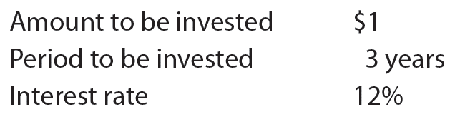
Present Value of an Amount
(slide 1 of 3)
Assume that you have $1 to invest as follows:

Slide 23
Present Value of an Amount
(slide 2 of 3)
After one year, the $1 earns interest of $0.12 ($1 × 12%) and, thus, will grow to $1.12 ($1 × 1.12).
In the second year, the $1.12 earns 12% interest of $0.134 ($1.12 × 12%) and, thus, will grow to $1.254 ($1.12 × $1.12) by the end of the second year.
By the end of the third year, your $1 investment will grow to $1.404.
This process of interest earning interest is called compounding.

Slide 24
Compound Amount of $1 for Three Periods at 12%

Slide 25
Present Value of an Amount
(slide 3 of 3)
On January 1, 2016, what is the present value of $1.404 to be received on December 31, 2018?
The partial present value of $1 table on the next slide indicates that the present value of $1 to be received in three years with earnings compounded at the rate of 12% per year is 0.712.

Slide 26
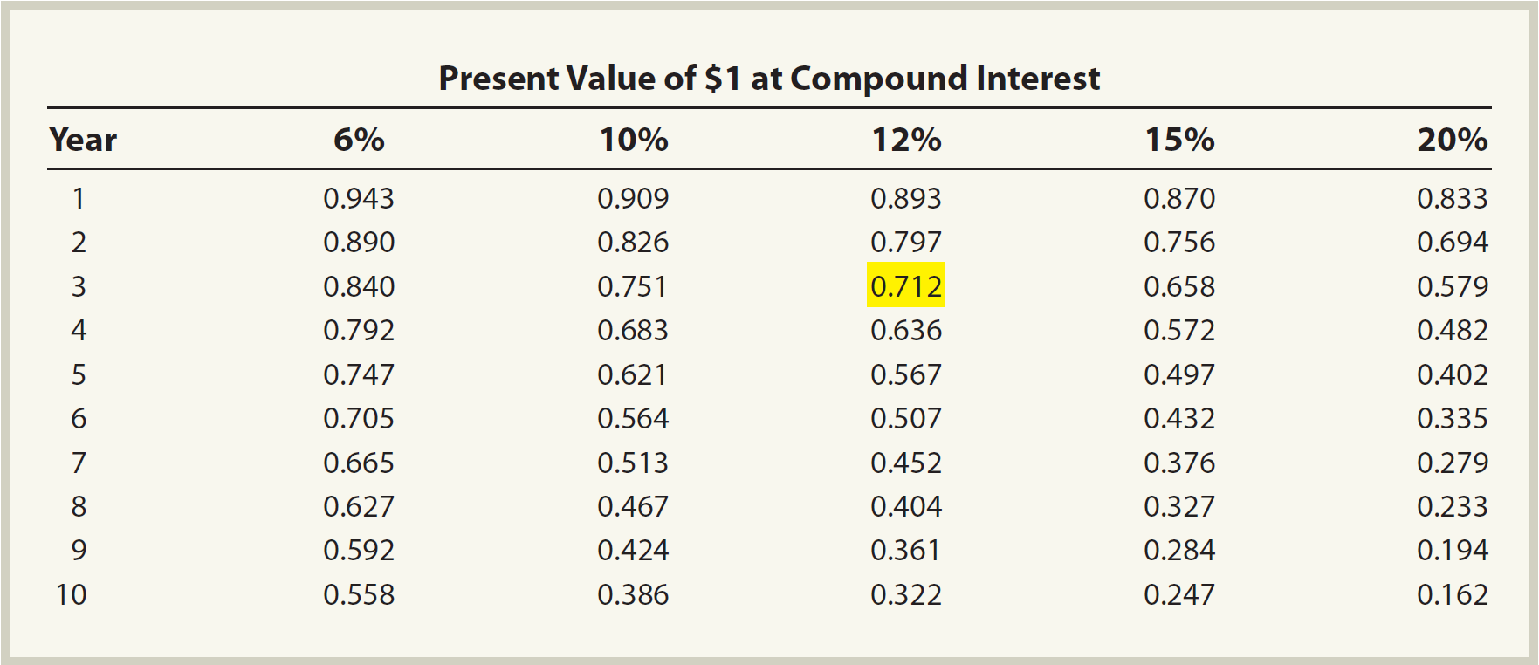
Partial Present Value of $1 Table

Slide 27
Present Value of an Amount of $1.404

Slide 28
Present Value of a $100 Amount for Five Consecutive Periods

Slide 29
Net Present Value Method and Index
The net present value method and present value index are often used in combination.

Slide 30
Net Present Value Method
(slide 1 of 6)
The net present value method compares the amount to be invested with the present value of the net cash inflows.
  It is sometimes called the discounted cash flow method.

Slide 31
Net Present Value Method
(slide 2 of 6)
The interest rate (return) used in net present value analysis is the company’s minimum desired rate of return.
  This rate, sometimes termed the hurdle rate, is based on such factors as the purpose of the investment and the cost of obtaining funds for the investment.
If the present value of the cash inflows equals or exceeds the amount to be invested, the proposal is desirable.

Slide 32
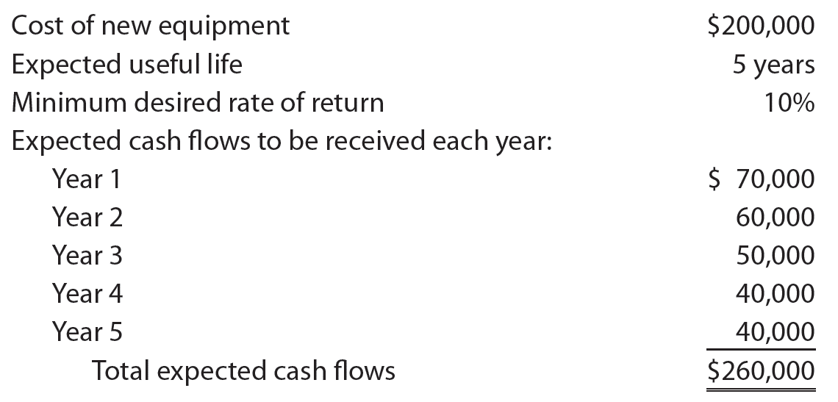
Net Present Value Method
(slide 3 of 6)
Assume the following data for a proposed investment in new equipment:

Slide 33
Partial Present Value of $1 Table

Slide 34
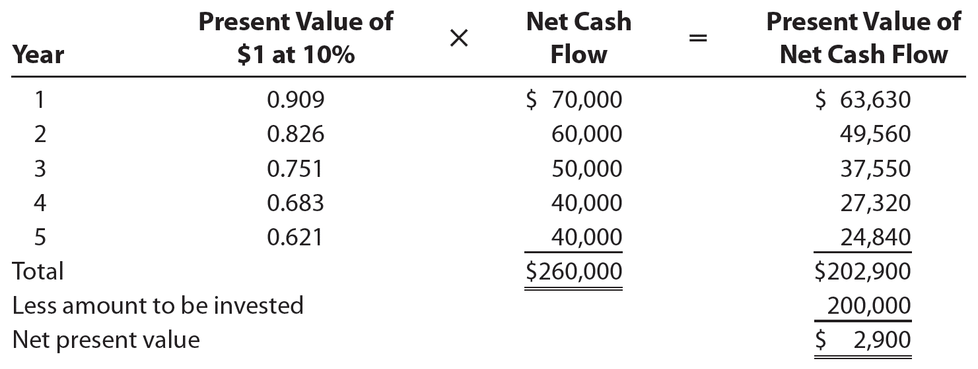
Net Present Value Method
(slide 4 of 6)
The present value of the net cash flow for each year is computed by multiplying the net cash flow for the year by the present value factor of $1 for that year, as follows:

Slide 35
Present Value of Equipment Cash Flows

Slide 36
Net Present Value Method
(slide 5 of 6)
The net present value of $2,900 indicates that the purchase of the new equipment is expected to recover the investment and provide more than the minimum rate of return of 10%. Thus, the purchase of the new equipment is desirable.

Slide 37
Net Present Value Method
(slide 6 of 6)
The net present value method has the following three advantages:
  It considers the cash flows of the investment.
  It considers the time value of money.
  It can rank projects with equal lives, using the present value index.
The net present value method has the following two disadvantages:
  It has more complex computations than methods that don’t use present value.
  It assumes the cash flows can be reinvested at the minimum desired rate of return, which may not be valid.

Slide 38
Present Value of an Annuity
(slide 1 of 4)
An annuity is a series of equal net cash flows at fixed time intervals.
  Cash payments for monthly rent, salaries, and bond interest are all examples of annuities.
The present value of an annuity is the amount of cash needed today to yield a series of equal net cash flows at fixed time intervals in the future.

Slide 39
Present Value of an Annuity
(slide 2 of 4)
The present value of a $100 annuity for five periods at 12% could be determined by using the present value factors in the partial present value of $1 table (see slide 26). Each $100 net cash flow could be multiplied by the present value of $1 at a 12% factor for the appropriate period and summed to determine a present value of $360.50.

Slide 40
Present Value of an Annuity
(slide 3 of 4)
Using a present value of an annuity table, such as the one on the next slide, is a simpler approach.

Slide 41
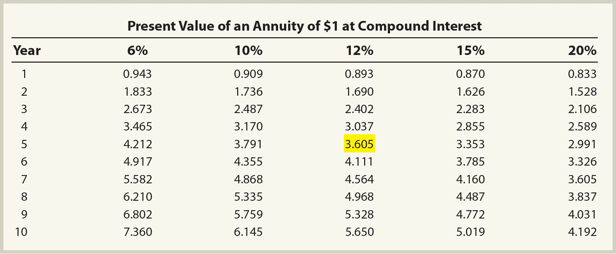
Partial Present Value of an Annuity Table

Slide 42
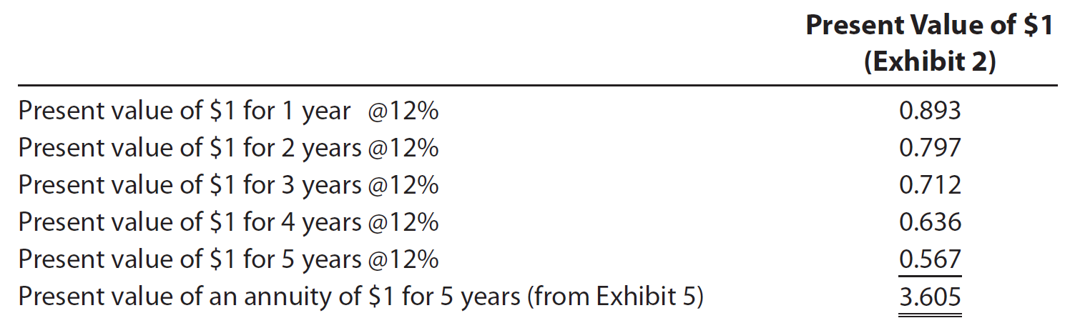
Present Value of an Annuity
(slide 4 of 4)
The present value factors in the table are the sum of the present value of $1 factors (see slide 26) for the number of annuity periods. Thus, 3.605 in the annuity table is the sum of the five present value of $1 factors at 12% (see slide 26), computed as follows:

Slide 43
Present Value Index
(slide 1 of 4)
When capital investment funds are limited and the proposals involve different investments, a ranking of the proposals can be prepared using a present value index.
The present value index is computed as follows:
Total Present Value of Net Cash Flow
Amount to Be Invested
Present Value Index =

Slide 44
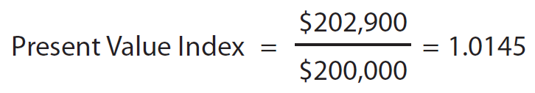
Present Value Index
(slide 2 of 4)
The present value index for the investment in the preceding slides is 1.0145, computed as follows:

Slide 45
Present Value Index
(slide 3 of 4)
A project will have a present value index greater than 1 when the net present value is positive.
When the net present value is negative, the present value index will be less than 1.

Slide 46
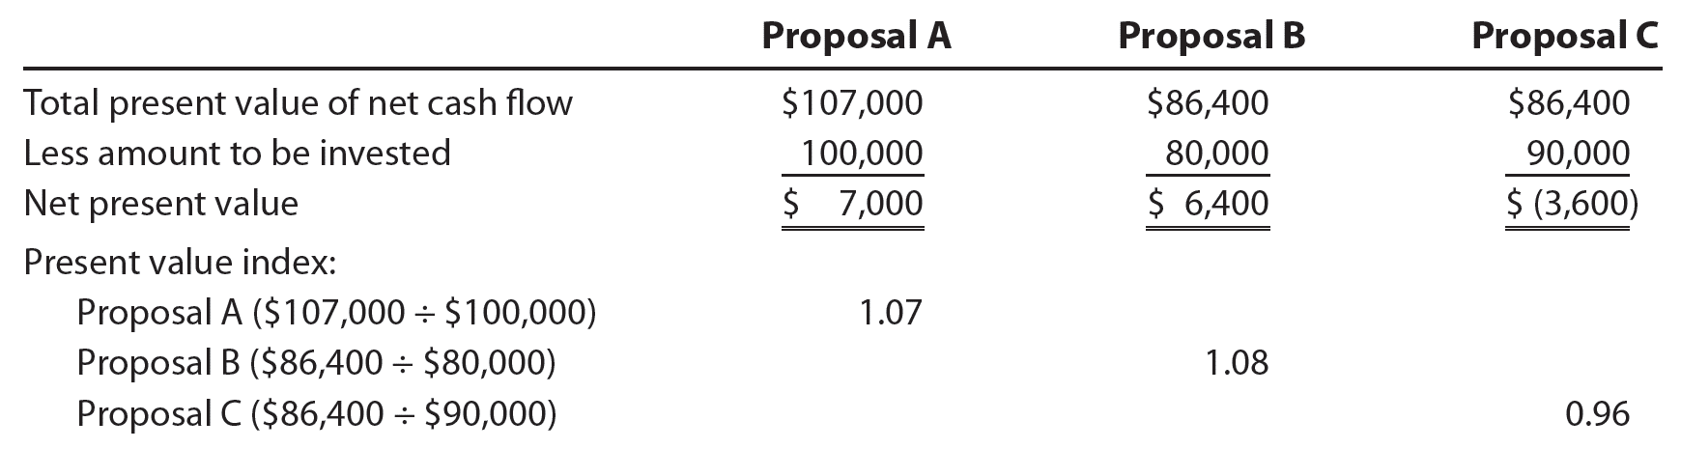
Present Value Index
(slide 4 of 4)
Assume that a company is considering three proposals. The net present value and the present value index for each proposal are as follows:
  Proposal B is the most desirable.
    Proposal B returns $1.08 present value per dollar invested, whereas Proposal A returns only $1.07.
    Proposal B requires an investment of $80,000, compared to an investment of $100,000 for Proposal A.

Slide 47
Internal Rate of Return Method
(slide 1 of 6)
The internal rate of return (IRR) method uses present value concepts to compute the rate of return from a capital investment proposal based on its expected net cash flows.
  This method, sometimes called the time-adjusted rate of return method, starts with the proposal’s net cash flows and works backward to estimate the proposal’s expected rate of return.

Slide 48
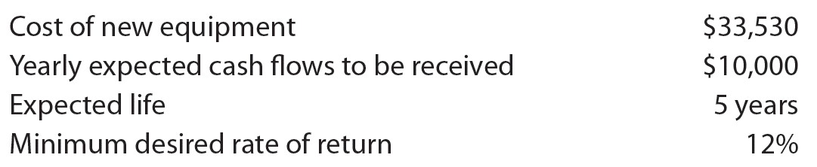
Internal Rate of Return Method
(slide 2 of 6)
Assume that management is evaluating the following proposal to purchase new equipment:

Slide 49
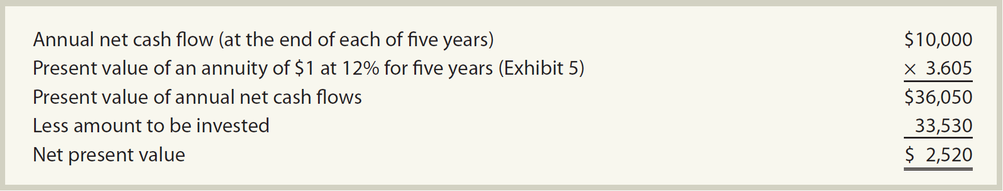
Net Present Value Analysis at 12%

Slide 50
Internal Rate of Return Method
(slide 3 of 6)
The $36,050 present value of the cash inflows, based on a 12% rate of return, is greater than the $33,530 to be invested. Thus, the internal rate of return must be greater than 12%.
Through trial and error, the rate of return equating the $33,530 cost of the investment with the present value of the net cash flows can be determined to be 15%.

Slide 51
Present Value of an Annuity at the Internal Rate of Return Rate

Slide 52
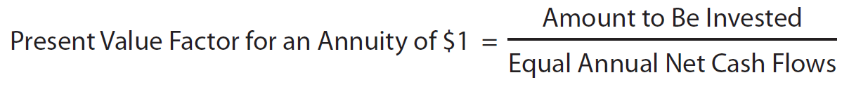
Internal Rate of Return Method
(slide 4 of 6)
When equal annual net cash flows are expected from a proposal, the internal rate of return can be determined as follows:
  Step 1: Determine a present value factor for an annuity of $1 as follows:
  Step 2: Locate the present value factor determined in Step 1 in the present value of an annuity of $1 table (see slide 32) as follows:
    Locate the number of years of expected useful life of the investment in the Year column.
    Proceed horizontally across the table until you find the present value factor computed in Step 1.
  Step 3: Identify the internal rate of return by the heading of the column in which the present value factor in Step 2 is located.

Slide 53
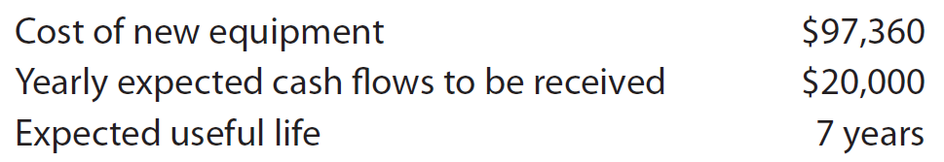
Internal Rate of Return Method
(slide 5 of 6)
Assume that management is evaluating the following proposal to purchase new equipment:

Slide 54
Partial Present Value of an Annuity Table

Slide 55
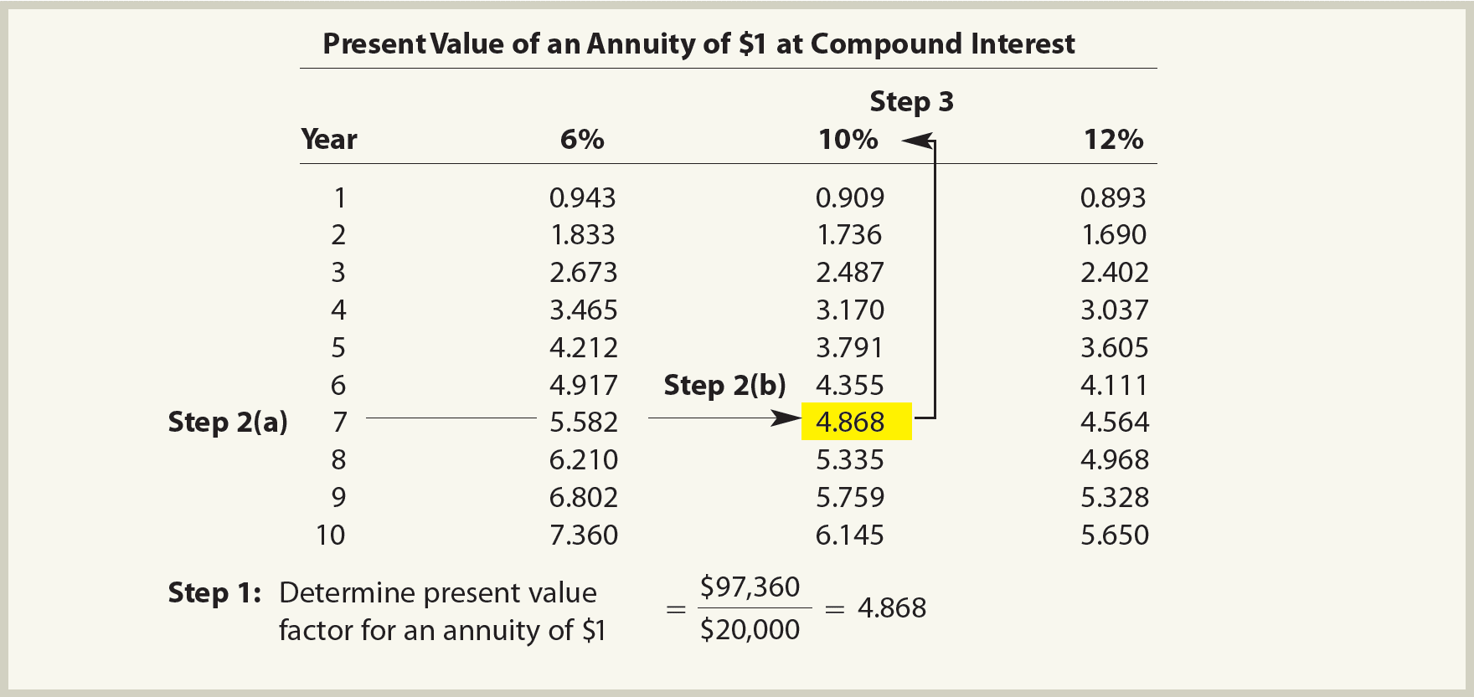
Partial Present Value of an Annuity Table

Slide 56
Internal Rate of Return Method
(slide 6 of 6)
The internal rate of return method has the following three advantages:
  It considers the cash flows of the investment.
  It considers the time value of money.
  It ranks proposals based upon the cash flows over their complete useful life, even if the project lives are not the same.
The internal rate of return method has the following two disadvantages:
  It has complex computations, requiring a computer if the periodic cash flows are not equal.
  It assumes the cash received from a proposal can be reinvested at the internal rate of return, which may not be valid.

Slide 57
Check Up Corner
Net Present Value and Internal Rate
of Return Analyses

Slide 58
Factors That Complicate Capital Investment Analysis
Additional factors such as the following may impact capital investment decisions:
  Income tax
  Proposals with unequal lives
  Leasing versus purchasing
  Uncertainty
  Changes in price levels
  Qualitative factors

Slide 59
Income Tax
The impact of income tax on capital investment decisions can be material.
  For example, in determining depreciation for federal income tax purposes, useful lives that are much shorter than actual useful lives are often used.
  Also, depreciation for tax purposes often differs from depreciation for financial statement purposes. As a result, the timing of the cash flows for income taxes can have a significant impact on capital investment analysis.

Slide 60
Unequal Proposal Lives
(slide 1 of 2)
The prior capital investment illustrations assumed that the alternative proposals had the same useful lives. In practice, however, proposals often have different lives.

Slide 61
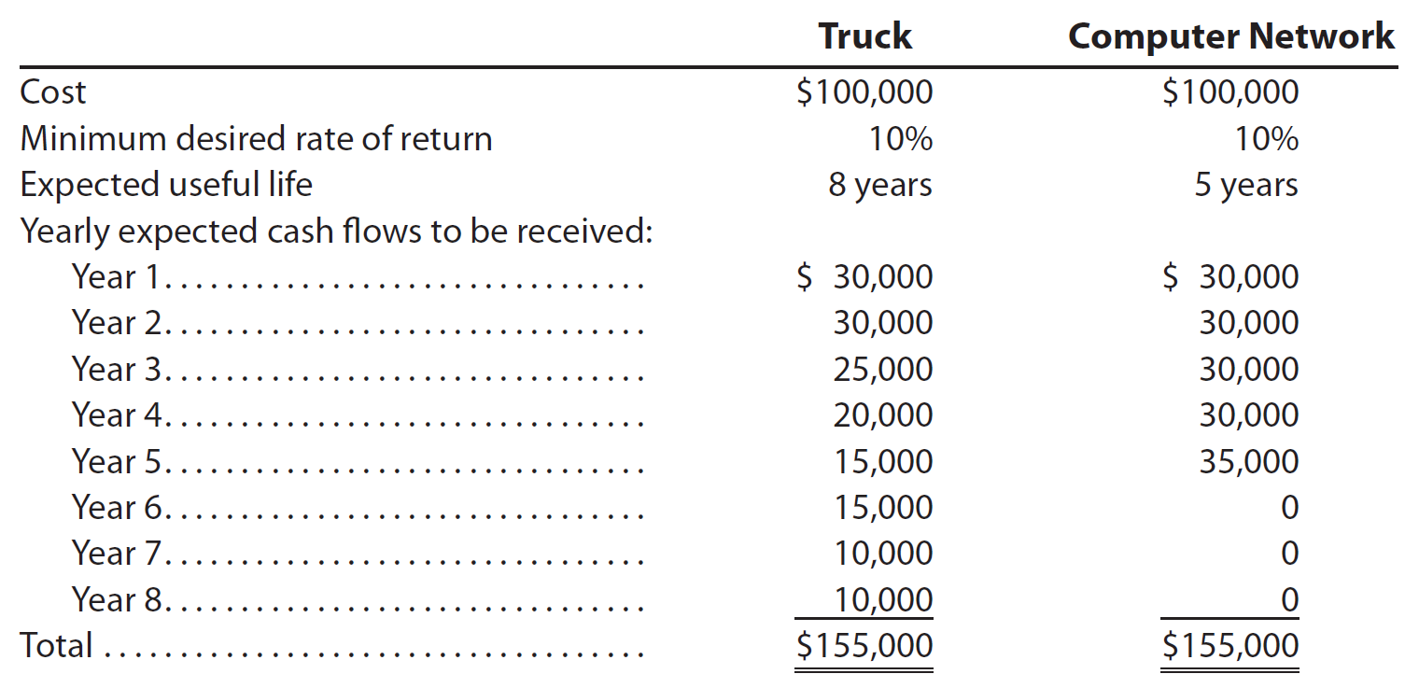
Unequal Proposal Lives
(slide 2 of 2)
Assume that a company is considering purchasing a new truck or a new computer network. The data for each proposal follows:

Slide 62
Net Present Value Analysis—Unequal Lives of Proposals (Top)
Net Present Value Analysis—Equalized Lives of Proposals (Bottom)

Slide 63
Check Up Corner
Net Present Value—Unequal Lives

Slide 64
Lease versus Capital Investment
Some advantages of leasing a fixed asset include the following:
  The company has use of the fixed asset without spending large amounts of cash to purchase the asset.
  The company eliminates the risk of owning an obsolete asset.
  The company may deduct the annual lease payments for income tax purposes.
A disadvantage of leasing a fixed asset includes the following:
  It is normally more costly than purchasing the asset.
    This is because the lessor (owner of the asset) includes in the rental price not only the costs of owning the asset, but also a profit.

Slide 65
Uncertainty
All capital investment analyses rely on factors that are uncertain.
  For example, estimates of revenues, expenses, and cash flows are uncertain.

Slide 66
Changes in Price Levels
(slide 1 of 2)
Price levels normally change as the economy improves or deteriorates.
  General price levels often increase in a rapidly growing economy, which is called inflation.
    During such periods, the rate of return on an investment should exceed the rising price level.
  If this is not the case, the cash returned on the investment will be less than expected.

Slide 67
Changes in Price Levels
(slide 2 of 2)
Price levels may also change for foreign investments.
  This occurs as currency exchange rates change.
    Currency exchange rates are the rates at which currency in another country can be exchanged for U.S. dollars.
      If the amount of local dollars that can be exchanged for one U.S. dollar increases, then the local currency is said to be weakening to the dollar.
        When a company has an investment in another country where the local currency is weakening, the return on the investment, as expressed in U.S. dollars, is adversely impacted.
          This is because the expected amount of local currency returned on the investment would purchase fewer U.S. dollars.

Slide 68
Qualitative Considerations
Some benefits of capital investments are qualitative in nature and cannot be estimated in dollar terms.
Some examples of qualitative considerations that may influence capital investment analysis include the investment proposal’s impact on the following:
  Product quality
  Manufacturing flexibility
  Employee morale
  Manufacturing productivity
  Market (strategic) opportunities

Slide 69
Capital Rationing
Capital rationing is the process by which management allocates funds among competing capital investment proposals.
  Alternative proposals are initially screened by establishing minimum standards, using the cash payback and the average rate of return methods.
  The proposals that survive this screening are further analyzed, using the net present value and internal rate of return methods.
  At the end of the capital rationing process, accepted proposals are ranked and compared with the funds available.
    Proposals that are selected for funding are included in the capital expenditures budget.
    Unfunded proposals may be reconsidered if funds later become available.

Slide 70
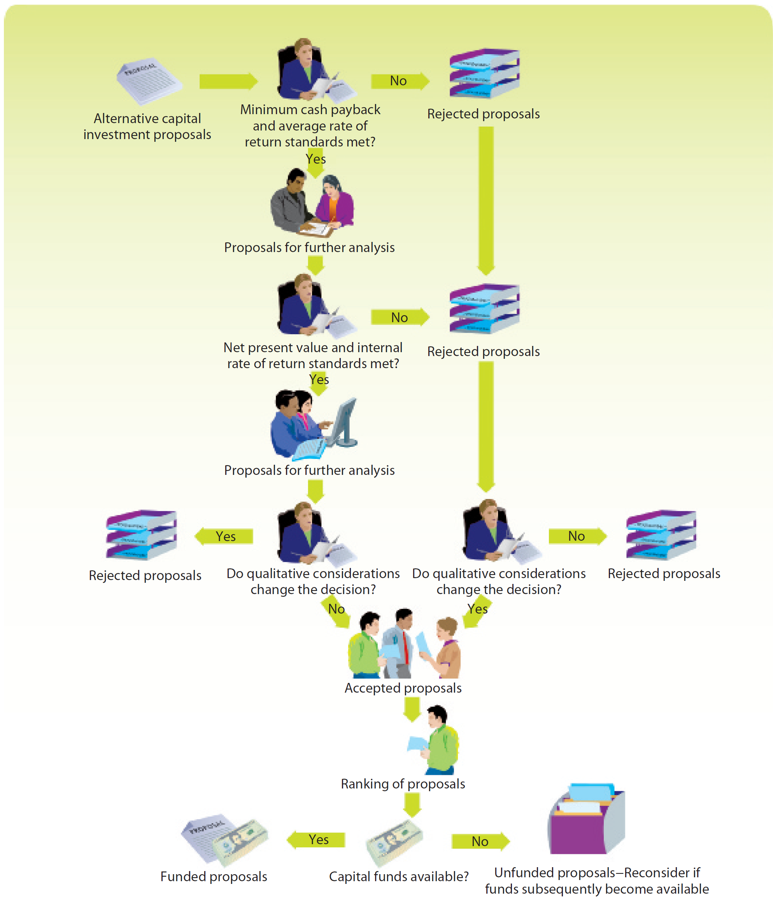
Capital Rationing Decision Process

